Slide 1
SMART HOME
Professor:
Andrea Irace
Students:
Piero Coletta
Felice Iusto
David Romero
Damiano Rosamilio
Victor Borrero
Academic Year 2018/2019

Slide 2
INDEX
Objective
Functionality and programming
Smart Home App
Circuit Schematic
Pcb design
Energy consuption
Bill of materials
Conclusion

Slide 3
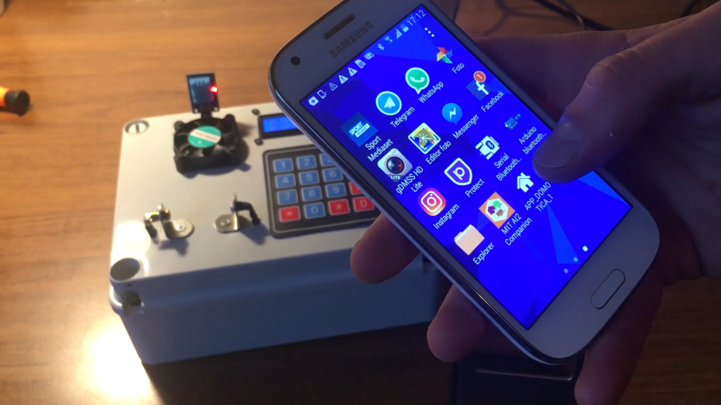
1. Objective
Our project aims to create an anti-intrusion and temperature control system for a domestic environment based on an ATMEGA – 328P microcontroller. This system can be managed by both a keypad and a smartphone via a bluetooth connection.

Slide 4
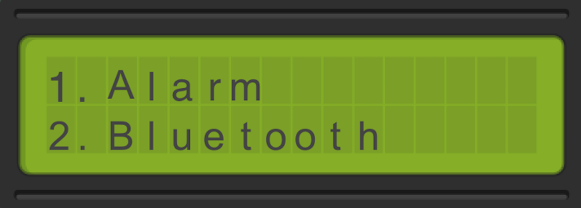
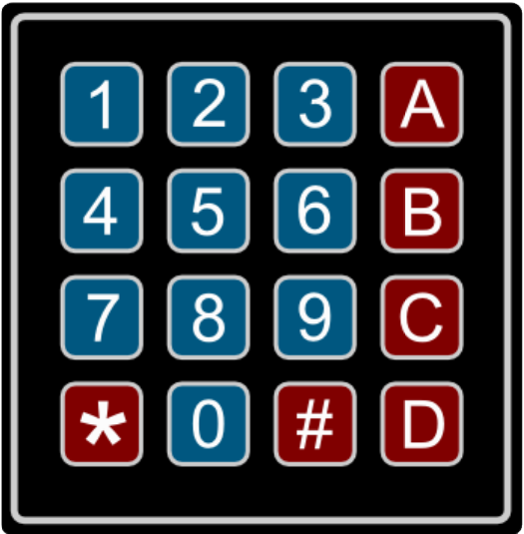
2. Functionality and programming
Alarm
On
Off
Bluetooth
On
Off
Temperature
Information
Threshold
Change threshold
Fun
On
Off
Password
Change password
Reset
Left
Right

Slide 5
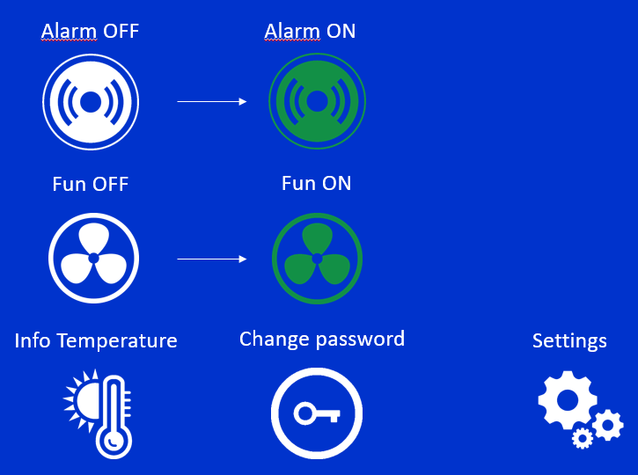
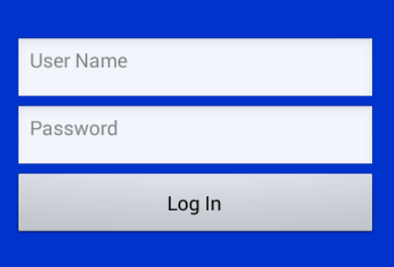
3. Smart Home App
1. Login Screen
2. Control Panel
The application was developed through the use of MIT App Inventor and consists of two main screens.
1. Login screen
2. Control panel
At the first login the user name and password are both admin

Slide 6
4. Circuit Schematic

Slide 7
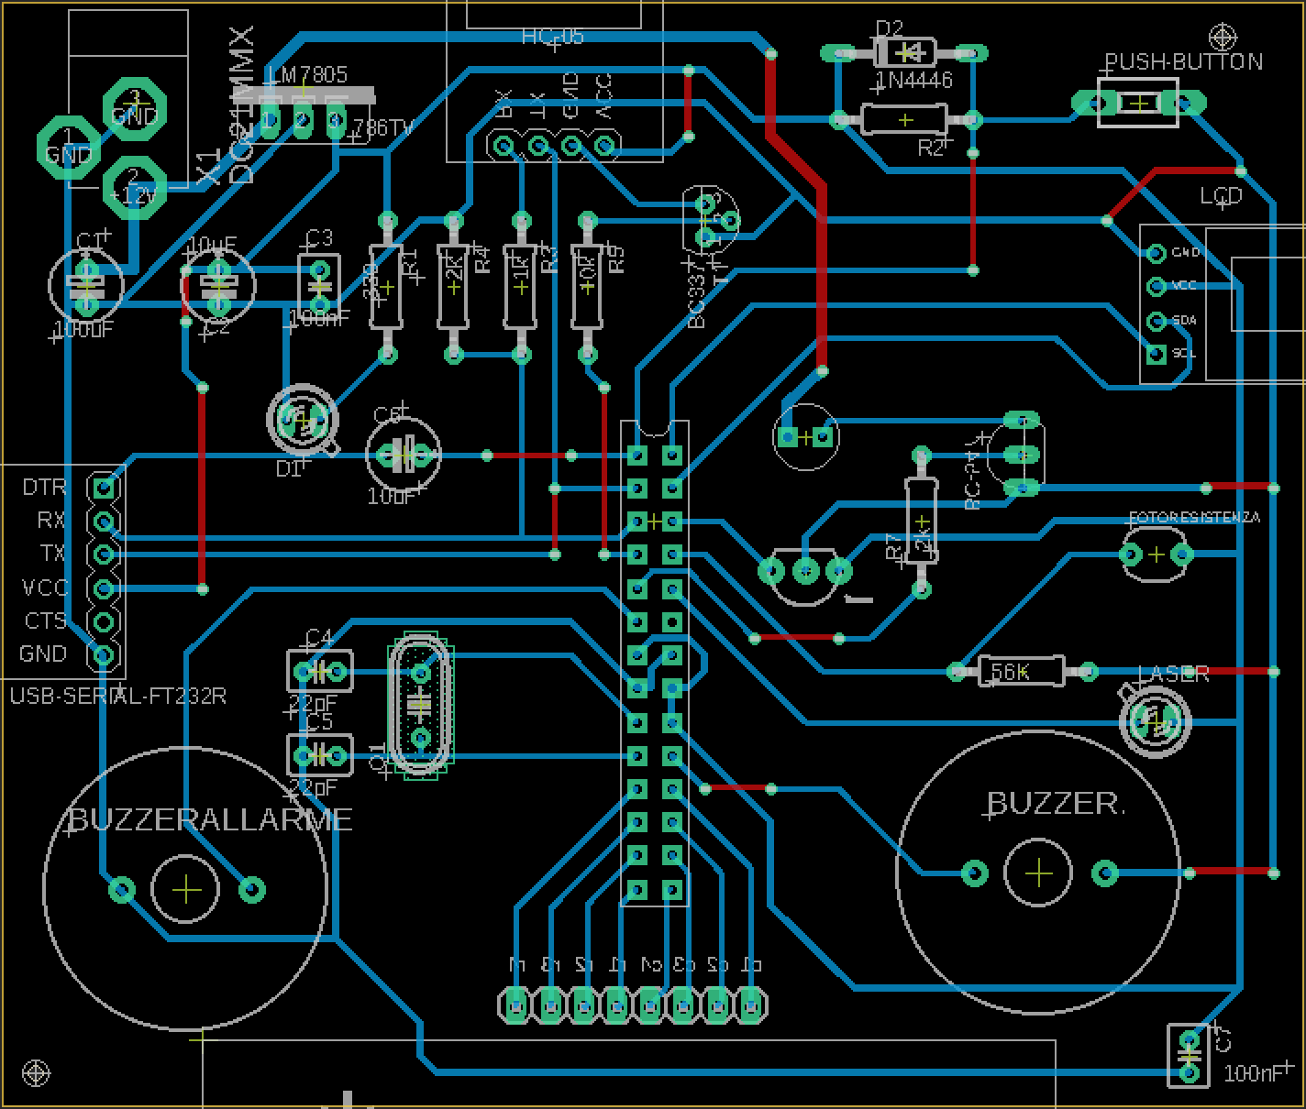
5. PCB Design

Slide 8
6. Energy consuption

Slide 9
7. Bill of Materials
N° | COMPONENT’S NAME | SINGLE COMPONENT’S COST
1 | ATmega328P | € 1,56
1 | HC49S, 16MHz Crystal Oscillator Quartz | € 0,252
1 | L7805, Positive Voltage Regulatore | € 0,169
1 | 1N414B, Diode | € 0,126
1 | Push Button
1 | 100μF Electrolytic Capacitor | € 0,187
1 | 10μF Electrolytic Capacitor | € 0,256
2 | 22pF Ceramic Capacitor | € 0,20 x2
2 | 100pF Ceramic Capacitor | € 0,20 x2
1 | FT232RL FTDI USB to TTL | € 9,05
1 | Dispaly LCD 16X2 with I2C interface | €
1 | BC547 Transistor NPN | € 0,078
1 | Keypad 4x4 | €
1 | HC-05 Bluetooth Module | €
2 | Buzzer 5Vdc, φ12mm | €0,908
2 | 2KΩ Resistor | € 0,019 x2
1 | 10KΩ Resistor | € 0,019
1 | 1KΩ Resistor | € 0,019
1 | 56KΩ Resistor | € 0,019
1 | 330Ω Resistor | € 0,013
1 | Laser Infrarossi | €
1 | DHT-11 Temperature-Humidity Sensor | € 5,40
1 | 12V Fan | €
1 | LDR, Light Depent Resistor | €

Slide 10
9. Conclusion
Home automation system achieved great popularity in the last decades and it increases the comfort and quality of life.
It provides easierand leisure living for every person.In this project, an approach for developing an IoT software-based smart home automation system was implemented and tested through the built model. It focuses on safety and security perspective of home automation throughusing some technologies. The technologies used in implementing this project are: ATMEGA - 328P as microcontroller, bluetooth module (HC - 05) for the smartphone's app

